Slide 1
EOSC for Physics & Astronomy
session wrap up
Challenges & open questions

Slide 2


EOSC for Physics & Astronomy
EOSC
European wide scalable infrastructure
Services supporting collaborative science
Cross domain fertilization
Radio Astronomy case
Data-intensive distributed data processing services
Adaptable portable data-aware processing workflows
Connected storage & compute, minimizing data transfers
Sustainable science data repositories for open & FAIR sharing
Low threshold access for worldwide community
LOFAR as pathfinder for SKA
Demonstrate Radio Astronomy Science Data Center services
ASTRON partner in ESCAPE
Hanno Holties – EOSC-hub week 2019, Prague

Slide 3
Identified Issues
Use of licensed software libraries (MATLAB, IDL, NAG,…)
Not sure how to deal with this in a generic way
Porting some IDL to Python
Resource Types
Need access to not just x86, but HPC and GPU (and possibly others)
Some codes difficult to containerise; need a container library (EOSC could provide based on Harbor?)
Could also allow common code used across disciplines to be containerized once!
Widely varying performance at different sites

Slide 4
FAIRness in Fusion?
Federated Authentication and Authorisation
Being worked on, but currently all sites have their own policies
Standard Metadata Model
Each site has their own. Tailored to the needs of fusion community (lots of TLAs and xTLAs)
No common standard format
Some sites use open format, some have specifically designed formats
No Standard access APIs
Not not ALL Bad news – ITER is having a major impact
Standard Data Model and Data Dictionary

Slide 5
Questions to EOSC (Hub)
Will the EOSC (via EOSC-hub) provide computing resources and how will the federation be organised in this case?
How deep will be a repository be integrated into the catalogue of services, who will take over maintenance and preservation of the repository?
How will the interfaces between EOSC-hub and the EOSC clusters be established and how will they be defined (e.g. for AAI and usage of computing and hosting resources)?
To which extent can science communities access compute and storage resources, and other services EOSC Hub provide?
How can use cases of different user communities affect the practical design of EOSC Hub interfaces?
As the volunteer use case is quite different to that of a policy maker or a practicing scientist.

Slide 6
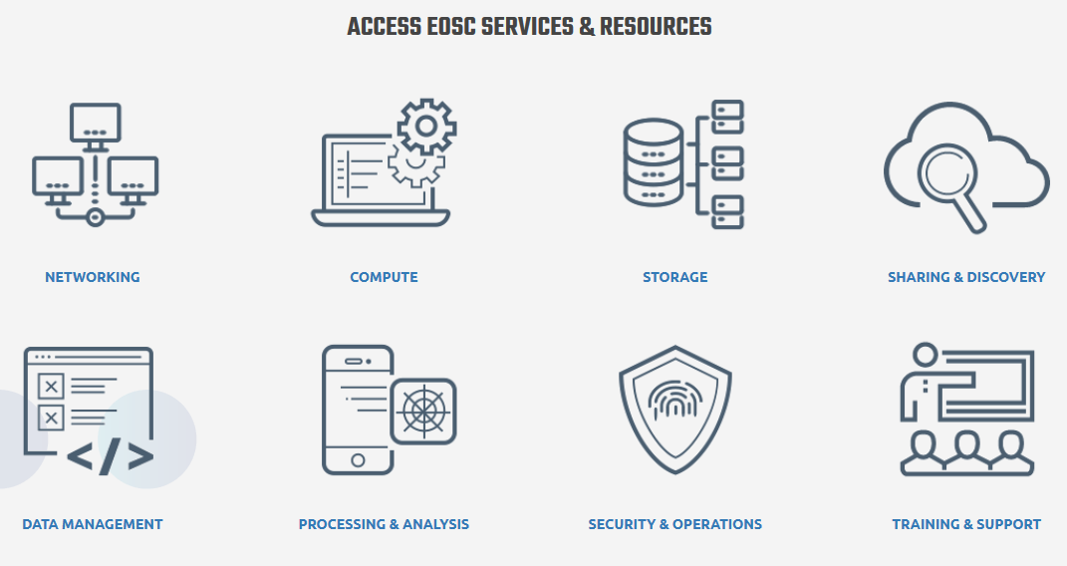
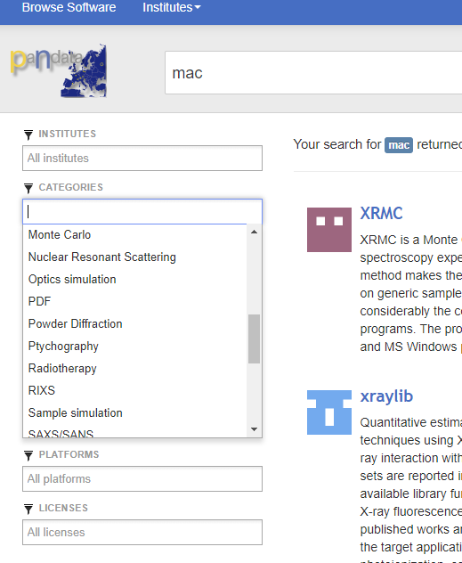

EOSC Portal, integrate model?
In its current form, it looks very much like an IT service portfolio
How do we integrate this Portal?
At the Service Level?
Do we link to our community portals?
Do we integrate into other communities’ portal?
IS EOSC a way to help us to build our community portal?
This project has received funding from the European Union's Horizon 2020 research and innovation programme under grant agreement No 823852

Slide 7
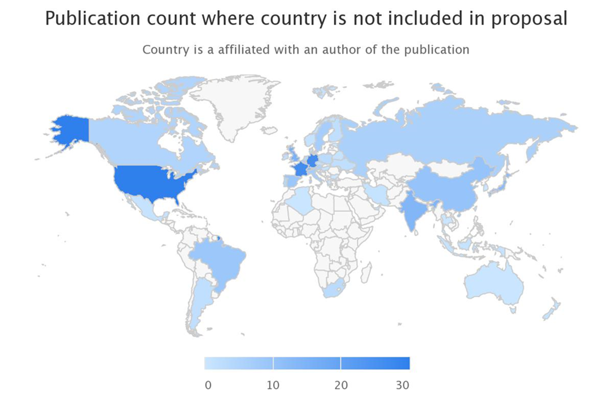
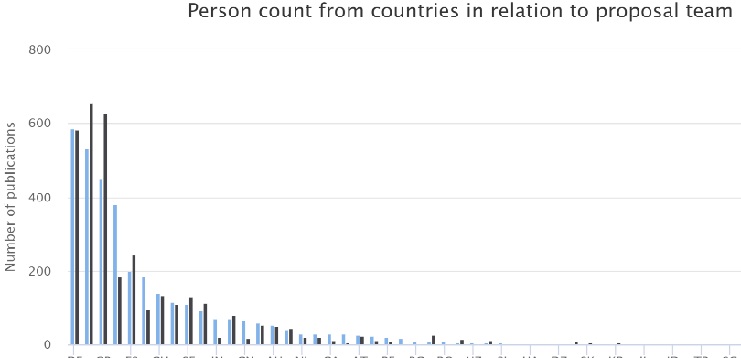
Sustainability?
Sustainability will come if FAIR data are re-used and contribute to increase knowledge at a reasonable cost.
How to prove evidence?
We had to develop our of tool
to track usage of data. (not
limited to OpenAccess)
Is it not of general interest?
Data-sources
Document
Corpus creation
Corpus of
document
Document analysis
Enhanced
document
Document matching
Match
candidate
Human validation
Match
Statistics computation
Result
presentation
This project has received funding from the European Union's Horizon 2020 research and innovation programme under grant agreement No 823852

Slide 8
Further discussions
Is EOSC for big communities, or for the long-tail?
Performance monitoring - Who, when?
EOSC portal - one or several or many? Involve Scientists at design level
How to get ‘good metrics’ that would incentive funding agencies to fund the infrastructure?
We are EOSC! EOSC is not ‘them’. We should all contribute to EOSC, and the question is what should happen within the disciplinary communities, what should happen ‘centrally’ for everybody (See also the Commissioner’s point about whether EOSC is a coordination layer or an operational delivery project).

